Slide 1
webMethods R&D Process Overview
Harish Krishnaswamy

Slide 2
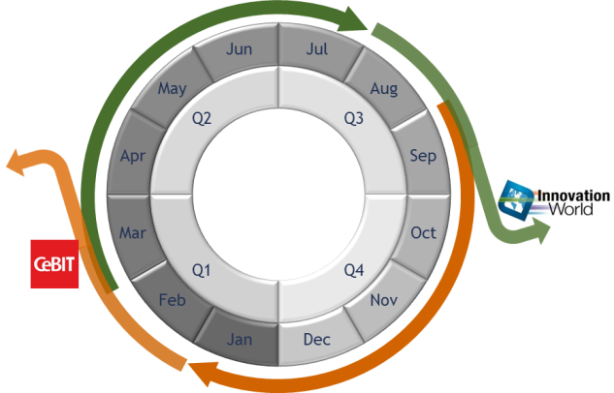


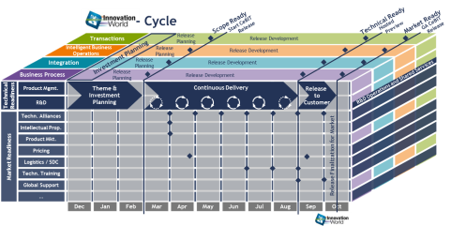
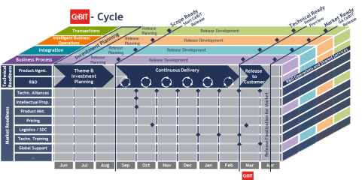
Innovation by 6-Month Releases
2 Releases per Year
-Release
-Release
Shorter cycle & Fixed schedule
Delivered by R&D with a defined and standardized process.
Notes:
For any impact consideration two dimensions are relevant:
The release cycle becomes shorter
The release cycle gets a fixed schedule
Stakeholders should not only reflect about potential issues caused by the need to deliver more quickly but also about issues caused by the predefined timelines.

Slide 3

R&D Innovation Process Overview
Technical Ready
Market Ready
Start CeBIT Release
Hosted Preview
GA CeBIT Release
Scope Ready
Transactions
Release Planning
Release Development
Intelligent Business Operations
Release Planning
Release Development
Investment Planning
Integration
Release Planning
Release Development
Business Process
Release Planning
Release Development
Technical Readiness
Product Mgmt.
Theme & Investment Planning
Continuous Delivery
Release to Customer
R&D Operations and Shared Services
R&D
Market Readiness
Techn. Alliances
Intellectual Prop.
Product Mkt.
Pricing
Continuous Flow & Delivery
Controlled Investment
High Quality
Release Finalization for Market
Logistics / SDC
Techn. Training
Global Support
…
Jun
Jul
Aug
Sep
Oct
Nov
Dec
Jan
Feb
Mar
Apr
Notes:
For any impact consideration two dimensions are relevant:
The release cycle becomes shorter
The release cycle gets a fixed schedule
Stakeholders should not only reflect about potential issues caused by the need to deliver more quickly but also about issues caused by the predefined timelines.

Slide 4
Theme & Investment Planning
Technical Ready
Market Ready
Start CeBIT Release
Hosted Preview
GA CeBIT Release
Scope Ready
Transactions
Release Planning
Release Development
Intelligent Business Operations
Release Planning
Release Development
Investment Planning
Integration
Release Planning
Release Development
Business Process
Release Planning
Release Development
Technical Readiness
Product Mgmt.
Theme & Investment Planning
Continuous Delivery
Release to Customer
R&D Operations and Shared Services
R&D
Market Readiness
Techn. Alliances
Intellectual Prop.
Strategic Planning
Release Train Planning
Product Mkt.
Pricing
Release Finalization for Market
Logistics / SDC
Deliverables:
Theme list per unit (confirmed)
Ranked feature list
Investment plan contents
Exceptions defined
➔ Confidence vote on plan from PM and R&D techn. lead
Deliverables:
Theme list per unit
High-level global release calendar
Investment plan structure
➔ Agreement between CTO, CMO, PM and R&D
Techn. Training
Global Support
…
1st Draft Release Train Plan
Final Release Train Plan
Jun
Jul
Aug
Sep
Oct
Nov
Dec
Jan
Feb
Mar
Apr
Strategic Plan
Review CTO
Finetune & Refine
Notes:
For any impact consideration two dimensions are relevant:
The release cycle becomes shorter
The release cycle gets a fixed schedule
Stakeholders should not only reflect about potential issues caused by the need to deliver more quickly but also about issues caused by the predefined timelines.

Slide 5
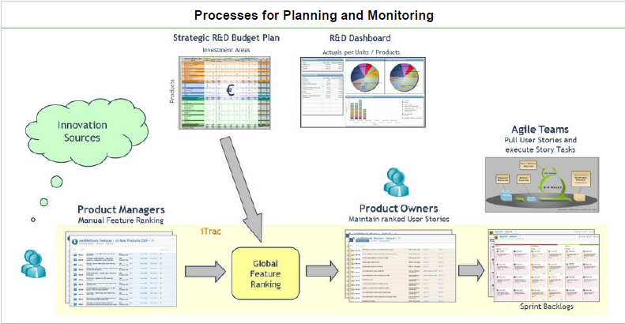

Slide 6
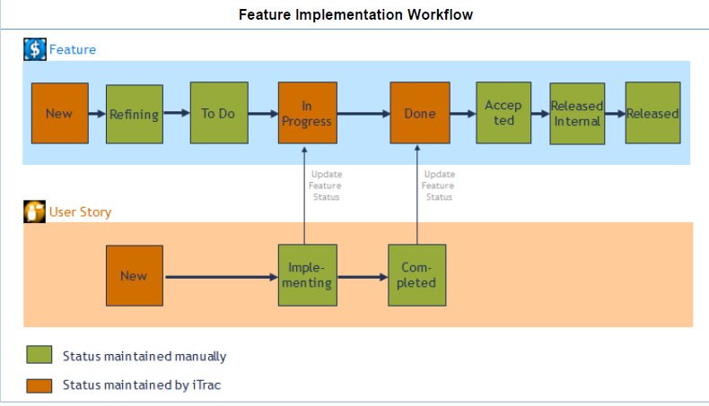

Slide 7
Release Development - Overview
Technical Ready
Market Ready
Start CeBIT Release
Hosted Preview
GA CeBIT Release
Scope Ready
Transactions
Release Planning
Release Development
Intelligent Business Operations
Release Planning
Release Development
Investment Planning
Integration
Release Planning
Release Development
Business Process
Release Planning
Release Development
Technical Readiness
Product Mgmt.
Theme & Investment Planning
Continuous Delivery
Release to Customer
R&D Operations and Shared Services
R&D
Market Readiness
Techn. Alliances
Intellectual Prop.
Product Mkt.
Pricing
Continuous Delivery
Release Finalization for Market
Logistics / SDC
Techn. Training
Recurring Cycles:
Refinement of iteration content
Incremental development
Automated continuous test process
Monthly snapshots
+ Ongoing monitoring
Snap- shot
Global Support
…
Develop & Test
Jun
Jul
Aug
Sep
Oct
Nov
Dec
Jan
Feb
Mar
Apr
Refine
Note: First and last delivery cycle of a release impacted by overlap with previous resp. succeeding release.
Notes:
For any impact consideration two dimensions are relevant:
The release cycle becomes shorter
The release cycle gets a fixed schedule
Stakeholders should not only reflect about potential issues caused by the need to deliver more quickly but also about issues caused by the predefined timelines.

Slide 8
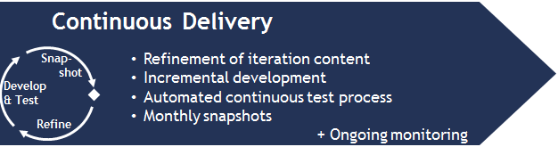
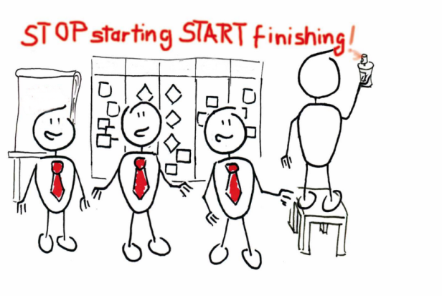
Release Development
Agile & Lean
All Software AG development teams work according to Agile Practices.
Practices are derived from Lean Principles, most critical attributes are:
Working from ranked backlog
Limiting work in progress
Clear time boxing of activities
Small teams working in collaborative fashion
Quality assurance is organized along the Lean Principles of continuous improvement, zero–defects mentality and stop–and-fix attitude.
Notes:
For any impact consideration two dimensions are relevant:
The release cycle becomes shorter
The release cycle gets a fixed schedule
Stakeholders should not only reflect about potential issues caused by the need to deliver more quickly but also about issues caused by the predefined timelines.

Slide 9
Overview (3) – How they all fit together
Investment
SuiteTest
$
Area
Suite Backlog
Feature
Breakdown
SuiteInt
SuiteProd
Snapshots
Architecture, Support ...
Ideas from Customers, Sales
Demo
Release
Build
Sprint Backlog

Implement

$
Marketable Feature
User Stories
Build Set
Shippable Build Set

Slide 10

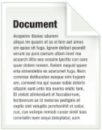

Release Development – Iterations
Breakdown from Investment Plan to User Stories
Ranked Backlogs for Features and User Stories
Teams pull User Stories from Backlog for implementation
Investment Plan
Themes
Features
User Stories
Team A
Products
Feature 1
Story 1
Feature 2
Story 2
Team B
Story 3
derive
Feature 3
…
…
Story 4
break down
Story 5
Team C
Story 6
break down
pull

Slide 11
Release Development - Continuous Test Process
High quality assurance by automated continuous test process:
Clearly defined and growing test bed
Failures get fixed immediately
Tests for both products and suite integration
Includes full regression testing
Team A
Product A
Team B
Product B
Cross Bus. Line
Integr.
Monthly Snapshot
Integration
Team C
Product C

Slide 12
Release Development – Monthly Snapshots
Output of continuously running assembly line
Increasing functionality and test coverage
Share progress and show new functionality and features early to internal stakeholders
Technical Ready
Market Ready
Start CeBIT Release
Hosted Preview
GA CeBIT Release
Scope Ready
Technical Readiness
Product Mgmt.
R&D
Jun
Jul
Aug
Sep
Oct
Nov
Dec
Jan
Feb
Mar
Apr
Monthly Snapshots

Slide 13
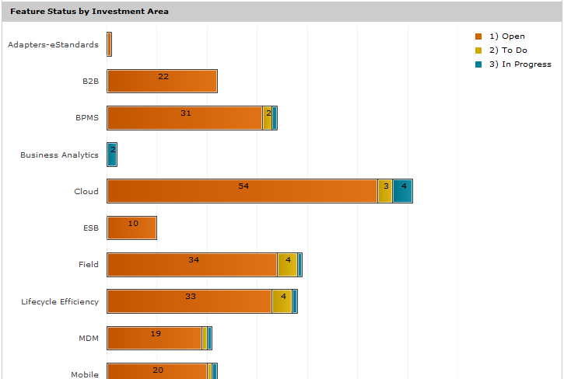
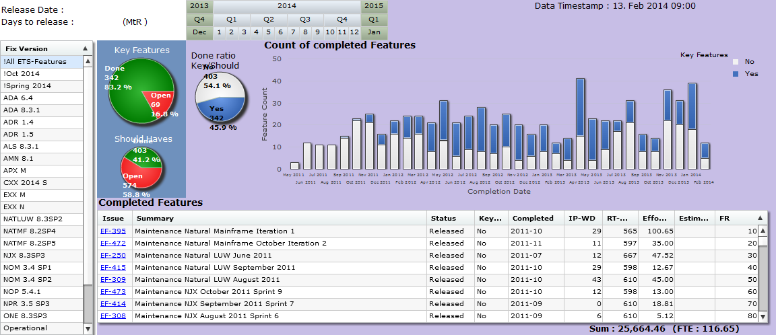
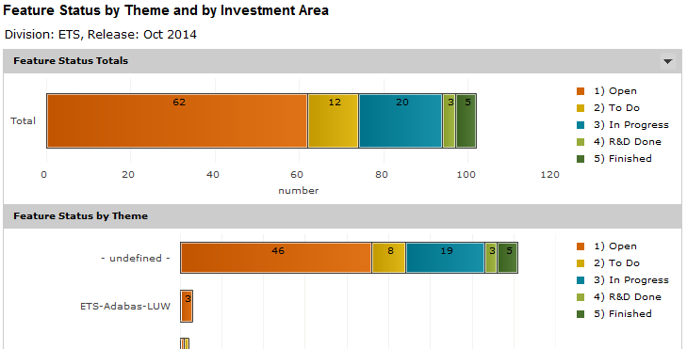
Release Development – Ongoing Monitoring
You cannot manage what you do not measure:
Monitor progress on Investment Plan, Themes and Features
Slicing and drill-downs (Total, Business Line, Product)

Slide 14
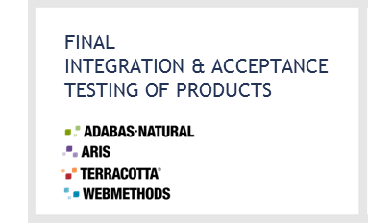
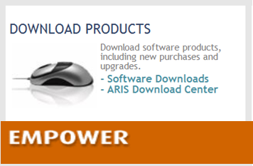
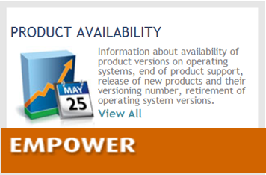
Release to Customer
Technical Ready
Market Ready
Start CeBIT Release
Hosted Preview
GA CeBIT Release
Scope Ready
Transactions
Release Planning
Release Development
Intelligent Business Operations
Release Planning
Release Development
Investment Planning
Integration
Release Planning
Release Development
Business Process
Release Planning
Release Development
Technical Readiness
Product Mgmt.
Theme & Investment Planning
Continuous Delivery
Release to Customer
R&D Operations and Shared Services
R&D
Market Readiness
Techn. Alliances
Intellectual Prop.
Product Mkt.
Verify Software Download / Delivery
Make Software available to Customers
Pricing
Final Testing
Transfer to Download Center and Logistics
Release Finalization for Market
Logistics / SDC
Techn. Training
Global Support
…
Jun
Jul
Aug
Sep
Oct
Nov
Dec
Jan
Feb
Mar
Apr
Notes:
For any impact consideration two dimensions are relevant:
The release cycle becomes shorter
The release cycle gets a fixed schedule
Stakeholders should not only reflect about potential issues caused by the need to deliver more quickly but also about issues caused by the predefined timelines.

Slide 15
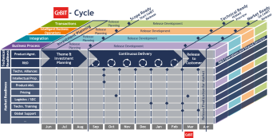
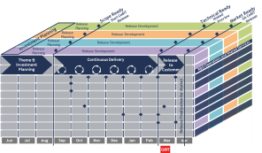

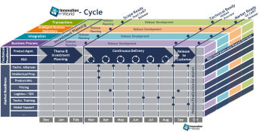
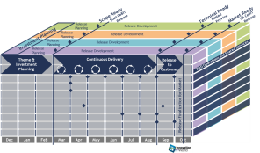

R&D Processes
Monitoring & Reporting
R&D Innovation
R&D Status Dashboard
Investment Status
Value
Delivery
Apr 2014
Oct 2014
Apr 2015
Oct 2015
Apr 2016
Oct 2016
Apr 2017
Oct 2017
…
Customer Sítuation
Product Quality
R&D Maintenance
Monitoring & Reporting
Note: Several releases under maintenance in parallel.

Slide 16
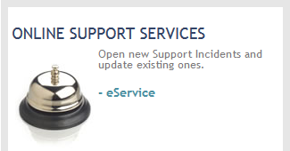

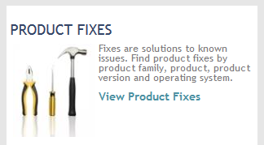
Maintenance Process
Monitoring & Reporting
R&D Innovation
R&D Status Dashboard
Investment Status
Value
Delivery
Apr 2014
Oct 2014
Apr 2015
Oct 2015
Apr 2016
Oct 2016
Apr 2017
Oct 2017
…
Fix & Service Release
Customer Sítuation
Product Quality
Global Support
Customer
Issue Analysis
Publicly available
for all
R&D Maintenance
Monitoring & Reporting
Customers
Issue Response

Slide 17
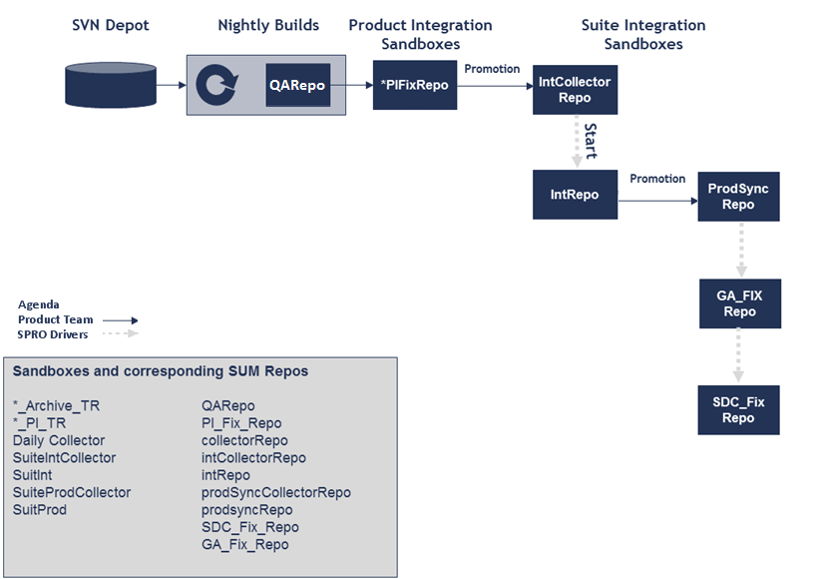
SPRO Promotion Process
SPRO BVT (weekly Thu. – Fri.) Install released Products from sandbox Install all released fixes (GA_Fix_Repo) Install your unreleased product fix
Software Download Center (SDC)
SPRO BIT (weekly Mon. – Wed.) Install released Products from sandbox Install all released fixes (GA_Fix_Repo) Install all unreleased fixes (IntRepo)
Notes:
Presentation Title
Date
Author
17

Slide 18
Thank you!

